Slide 1

William Stallings Computer Organization and Architecture 11th Edition

Slide 2
Chapter 4
Memory Hierarchy
Notes:
Although seemingly simple in concept, computer memory exhibits perhaps the widest
range of type, technology, organization, performance, and cost of any feature
of a computer system. No single technology is optimal in satisfying the memory
requirements for a computer system. As a consequence, the typical computer
system is equipped with a hierarchy of memory subsystems, some internal to the
system (directly accessible by the processor) and some external (accessible by the
processor via an I/O module).
This chapter and the next focus on internal memory elements, while Chapter 6
is devoted to external memory. To begin, the first section examines key characteristics
of computer memories. The remainder of the chapter examines an essential element
of all modern computer systems: cache memory.

Slide 3
4.3 Memory Hierarchy

Slide 4
Computer Memory
What are the different types of memories we have studied so far?
Notes:
The design constraints on a computer’s memory can be summed up by three questions:
How much? How fast? How expensive?
The question of how much is somewhat open ended. If the capacity is there,
applications will likely be developed to use it. The question of how fast is, in a sense,
easier to answer. To achieve greatest performance, the memory must be able to
keep up with the processor. That is, as the processor is executing instructions, we
would not want it to have to pause waiting for instructions or operands. The final
question must also be considered. For a practical system, the cost of memory must
be reasonable in relationship to other components.
As might be expected, there is a trade-off among the three key characteristics
of memory: capacity, access time, and cost. A variety of technologies are used to
implement memory systems, and across this spectrum of technologies, the following
relationships hold:
• Faster access time, greater cost per bit
• Greater capacity, smaller cost per bit
• Greater capacity, slower access time
The dilemma facing the designer is clear. The designer would like to use memory
technologies that provide for large-capacity memory, both because the capacity
is needed and because the cost per bit is low. However, to meet performance
requirements, the designer needs to use expensive, relatively lower-capacity memories
with short access times.
The way out of this dilemma is not to rely on a single memory component or
technology, but to employ a memory hierarchy.

Slide 5
Memory Hierarchy
Design constraints on a computer’s memory can be summed up by three questions:
How much, how fast, how expensive
There is a trade-off among capacity, access time, and cost
Faster access time, greater cost per bit
Greater capacity, smaller cost per bit
Greater capacity, slower access time
The way out of the memory dilemma is not to rely on a single memory component or technology, but to employ a memory hierarchy
Notes:
The design constraints on a computer’s memory can be summed up by three questions:
How much? How fast? How expensive?
The question of how much is somewhat open ended. If the capacity is there,
applications will likely be developed to use it. The question of how fast is, in a sense,
easier to answer. To achieve greatest performance, the memory must be able to
keep up with the processor. That is, as the processor is executing instructions, we
would not want it to have to pause waiting for instructions or operands. The final
question must also be considered. For a practical system, the cost of memory must
be reasonable in relationship to other components.
As might be expected, there is a trade-off among the three key characteristics
of memory: capacity, access time, and cost. A variety of technologies are used to
implement memory systems, and across this spectrum of technologies, the following
relationships hold:
• Faster access time, greater cost per bit
• Greater capacity, smaller cost per bit
• Greater capacity, slower access time
The dilemma facing the designer is clear. The designer would like to use memory
technologies that provide for large-capacity memory, both because the capacity
is needed and because the cost per bit is low. However, to meet performance
requirements, the designer needs to use expensive, relatively lower-capacity memories
with short access times.
The way out of this dilemma is not to rely on a single memory component or
technology, but to employ a memory hierarchy.

Slide 6
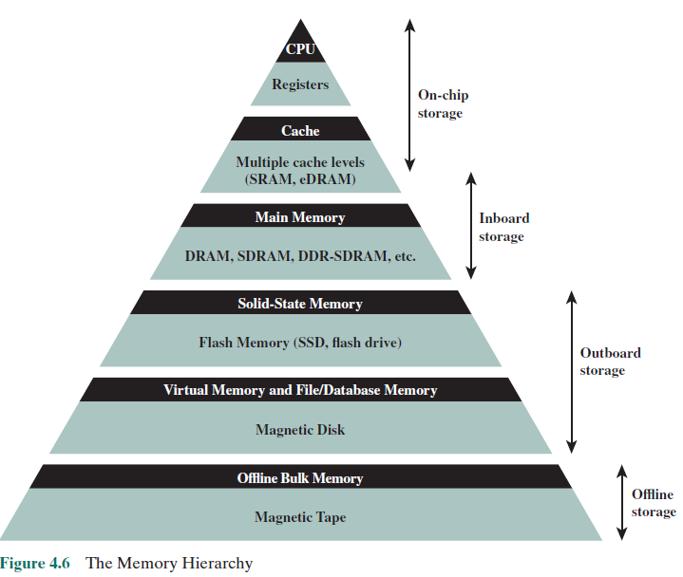
Memory Hierarchy
Cost?
Capacity?
Access Time?
Frequency of Access by Processor?
As one goes down the hierarchy, the following occur:
a. Decreasing cost per bit
b. Increasing capacity
c. Increasing access time
d. Decreasing frequency of access of the memory by the processor
Notes:
A typical hierarchy is illustrated in
Figure 4.1. As one goes down the hierarchy, the following occur:
a. Decreasing cost per bit
b. Increasing capacity
c. Increasing access time
d. Decreasing frequency of access of the memory by the processor
Thus, smaller, more expensive, faster memories are supplemented by larger,
cheaper, slower memories. The key to the success of this organization is item (d)
:decreasing frequency of access. We examine this concept in greater detail when we
discuss the cache, later in this chapter, and virtual memory in Chapter 8. A brief
explanation is provided at this point.
The use of two levels of memory to reduce average access time works in principle,
but only if conditions (a) through (d) apply. By employing a variety of technologies,
a spectrum of memory systems exists that satisfies conditions (a) through
(c). Fortunately, condition (d) is also generally valid.
The basis for the validity of condition (d) is a principle known as locality of
reference [DENN68]. During the course of execution of a program, memory references
by the processor, for both instructions and data, tend to cluster. Programs
typically contain a number of iterative loops and subroutines. Once a loop or subroutine
is entered, there are repeated references to a small set of instructions.
Similarly, operations on tables and arrays involve access to a clustered set of data
words. Over a long period of time, the clusters in use change, but over a short period
of time, the processor is primarily working with fixed clusters of memory references.

Slide 7
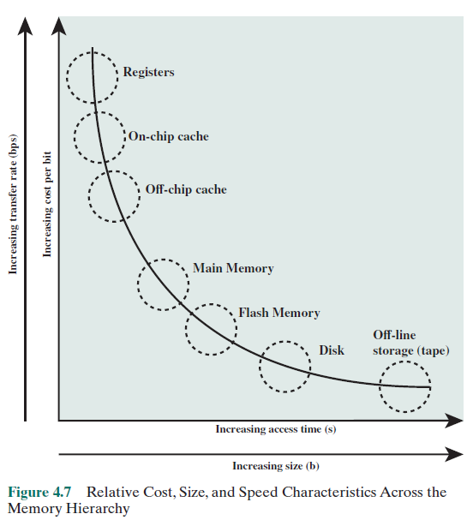
Memory Access
Let us label the memory at level i of the memory hierarchy Mi, such that Mi is closer to the processor than Mi+1.
Ci = cost per byte,
Ti = average access time,
Ri = average data transfer rate, and
Si = total memory size at level i,
then the following relationships typically hold between levels i and i + 1:
Ci > Ci+1
Ti < Ti+1
Ri > Ri+1
Si < Si+1

Slide 8
Memory
The use of three levels exploits the fact that semiconductor memory comes in a variety of types which differ in speed and cost
Data are stored more permanently on external mass storage devices
External, nonvolatile memory is also referred to as secondary memory or auxiliary memory
Disk cache
A portion of main memory can be used as a buffer to hold data temporarily that is to be read out to disk
A few large transfers of data can be used instead of many small transfers of data
Data can be retrieved rapidly from the cache rather than slowly from the disk
Notes:
The three forms of memory just described are, typically, volatile and employ
semiconductor technology. The use of three levels exploits the fact that semiconductor
memory comes in a variety of types, which differ in speed and cost. Data are
stored more permanently on external mass storage devices, of which the most common
are hard disk and removable media, such as removable magnetic disk, tape,
and optical storage. External, nonvolatile memory is also referred to as secondary
memory or auxiliary memory . These are used to store program and data files and
are usually visible to the programmer only in terms of files and records, as opposed
to individual bytes or words. Disk is also used to provide an extension to main memory
known as virtual memory, which is discussed in Chapter 8.
Other forms of memory may be included in the hierarchy. For example, large
IBM mainframes include a form of internal memory known as expanded storage.
This uses a semiconductor technology that is slower and less expensive than that
of main memory. Strictly speaking, this memory does not fit into the hierarchy but
is a side branch: Data can be moved between main memory and expanded storage
but not between expanded storage and external memory. Other forms of secondary
memory include optical and magneto-optical disks. Finally, additional levels can be
effectively added to the hierarchy in software. A portion of main memory can be
used as a buffer to hold data temporarily that is to be read out to disk. Such a technique,
sometimes referred to as a disk cache, improves performance in two ways:
■ Disk writes are clustered. Instead of many small transfers of data, we have
a few large transfers of data. This improves disk performance and minimizes
processor involvement.
■ Some data destined for write-out
may be referenced by a program before the
next dump to disk. In that case, the data are retrieved rapidly from the software
cache rather than slowly from the disk.
Appendix 4A examines the performance implications of multilevel memory
structures.

Slide 9
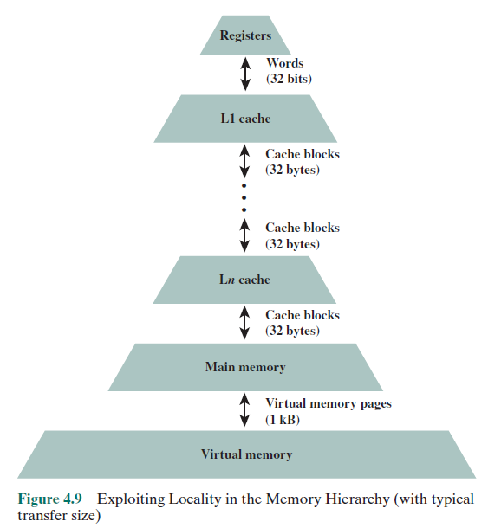
Memory Hierarchy Data Exchange

Slide 10
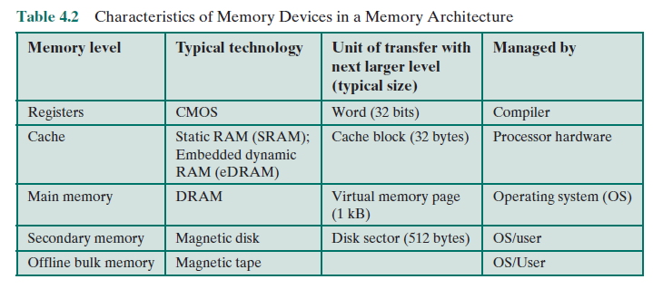
Memory Devices

Slide 11
Design Principles for a Memory Hierarchy
Locality: Locality is the principle that makes effective use of a memory hierarchy possible.
Inclusion: This principle dictates that all information items are originally stored in level Mn, where n is the level most remote from the processor. During the processing, subsets of Mn are copied into Mn-1. similarity, subsets of Mn -1 are copied into Mn-2, and so on. This is expressed concisely as Mi ⊆ Mi+1.
Coherence: Copies of the same data unit in adjacent memory levels must be consistent. If a word is modified in the cache, copies of that word must be updated immediately or eventually at all higher levels.

Slide 12
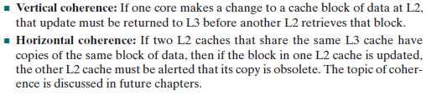
Coherence
Maintain the illusion that the memory is a single, unified entity, even though it may be distributed across multiple levels of caches and the main memory.
Coherence ensures that all processors in a multi-processor system observe a consistent view of memory, despite the presence of private caches that store copies of memory locations.
Vertical and Horizontal Coherence?

Slide 13
4.4 Performance Modeling of Multilevel Memory Hierarchy

Slide 14
Performance Modeling of a multilevel memory hierarchy
2-Level Memory Access
Cache acts as a buffer between main memory and processor creating a 2-level internal memory
A single level of cache to interact with main memory is rarely implemented

Slide 15
Operation of 2-Level Memory
Locality property can be exploited in the formation of a 2 level memory
Upper level memory M1 is smaller, faster and more expensive than lower level memory M2
M1 is used as a temporary store for part of the contents of the larger M2
When a reference is made, an attempt is made to access the item in M1, if this succeeds, quick access is made, if not, then a block of memory locations is copied from M2 to M1 and the access takes place

Slide 16
Average Access Time
To express the average time to access an item, we must consider not only the speeds of the two levels of memory, but also the probability that a given reference can be found in M1. We have
Ts = H * T1 + (1 - H) * (T1 + T2)
Ts = average (system) access time
T1 = access time of M1 (e.g., cache)
T2 = access time of M2 (e.g., main memory)
H = hit ratio (fraction of time reference is found in M1)

Slide 17
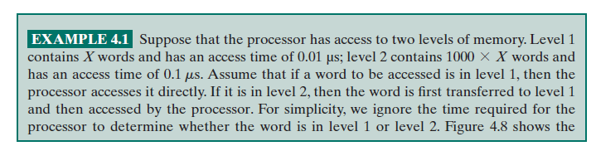

Memory Access Time

Slide 18
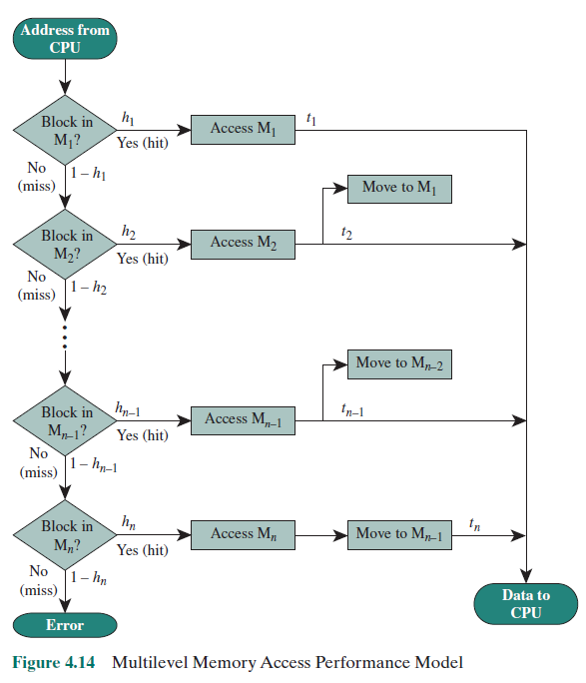
Performance Model

Slide 19
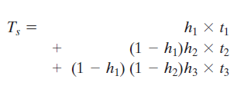
Access Time for Multi-level Memory Model

Slide 20
Summary
Memory Hierarchy
Chapter 4
Locality
Characteristics of Memory Systems
Memory Hierarchy
Memory Access Time
Notes:
Chapter 4 summary.

